Slide 1


Slide 2
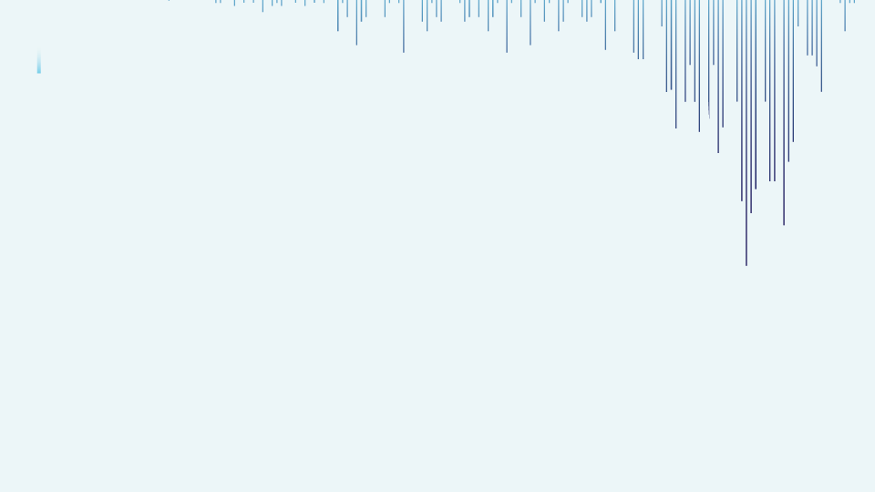

Automobile Car Prices Prediction
By:- Sayed Mohammed Faisal

Slide 3
Research Objective
The aim of my project is to build a model that can accurately predict the price of car based on various car features such as model, year, mileage, engine specification, fuel type etc.

Slide 4
Project Contents
Importing Libraries & Data Loading
EDA (Exploratory Data Analysis) & Preprocessing
Train & Test Split
Model Building
Linear Regression
Decision Tree
Random Forest
Support Vector Regression
XGBoost Regressor
Hyperparameter Tuning on Random Forest
All Models Tabled
Predicted Values By Models
Conclusion

Slide 5
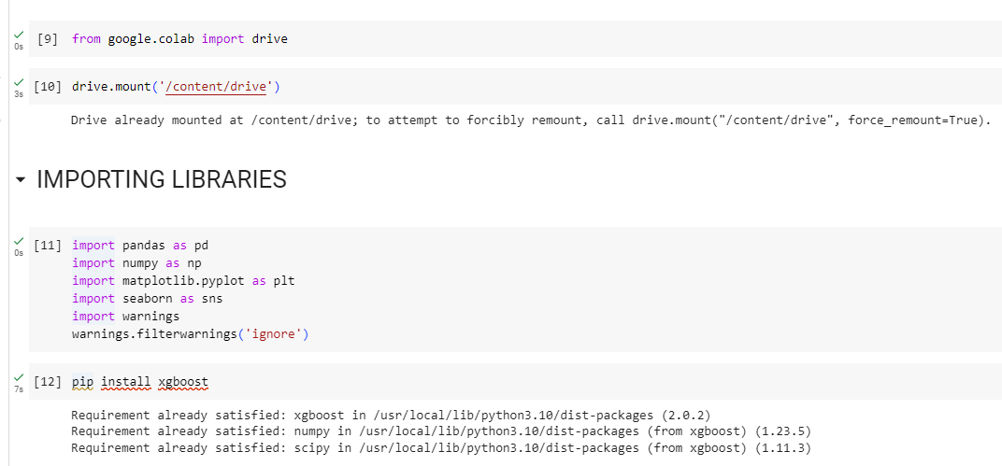
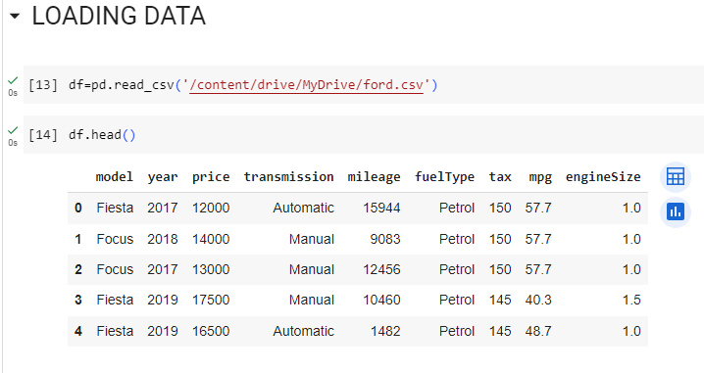
Importing Libraries & Data Loading
Libraries:-
Pandas (pd)
Numpy (np)
Matplotlib.pyplot (plt)
Seaborn (sns)
Installing XGBoost
Loading the data using pd.read_csv

Slide 6
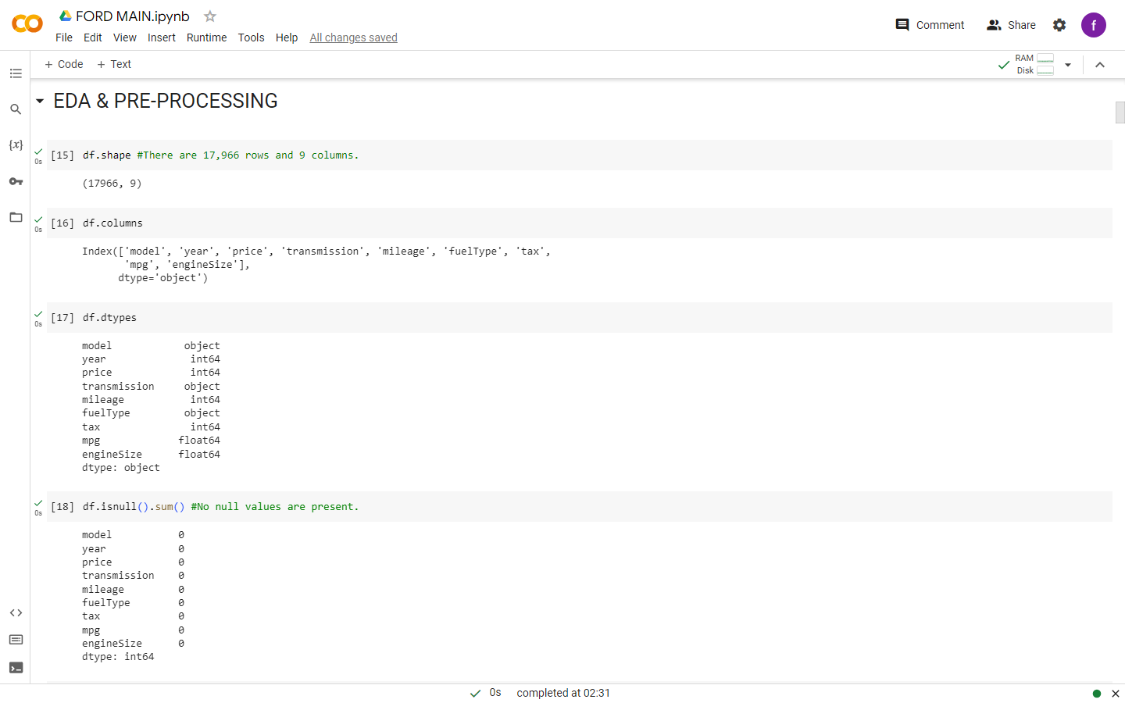
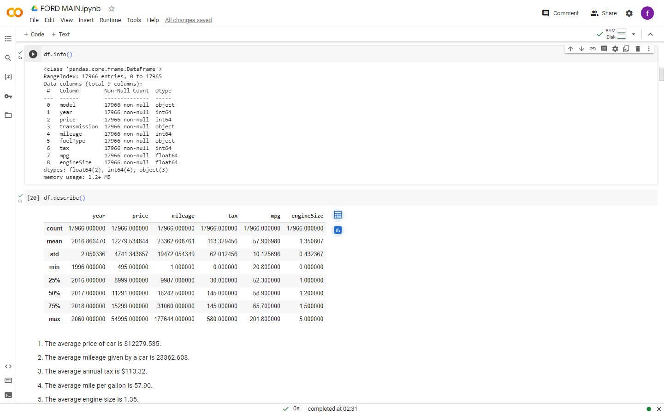
EDA (Exploratory Data Analysis) & Preprocessing

Slide 7
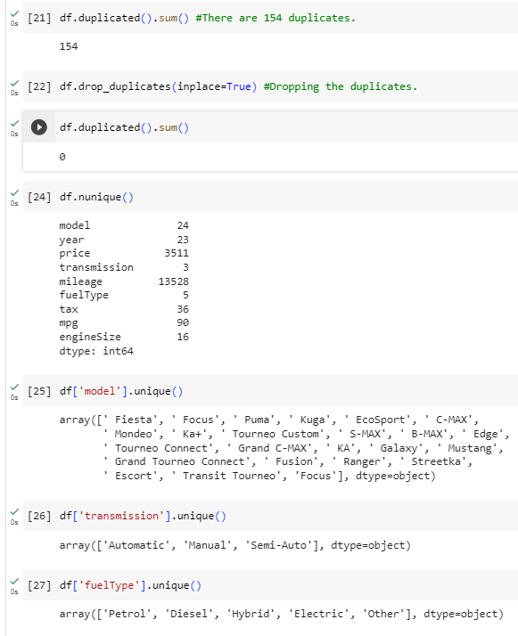
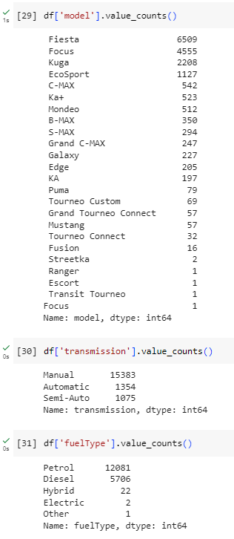
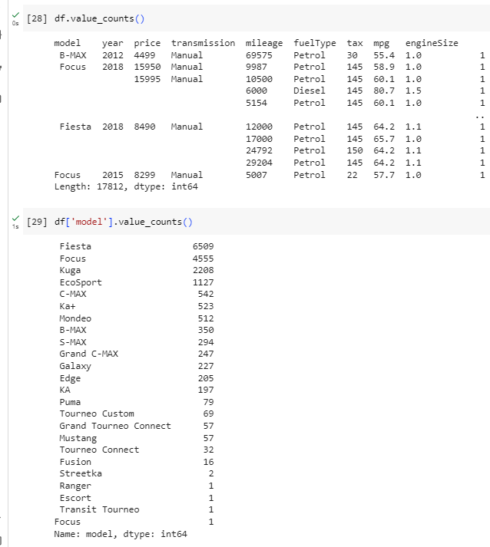

Slide 8
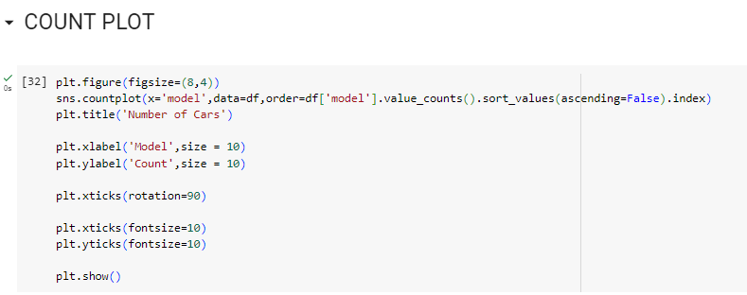
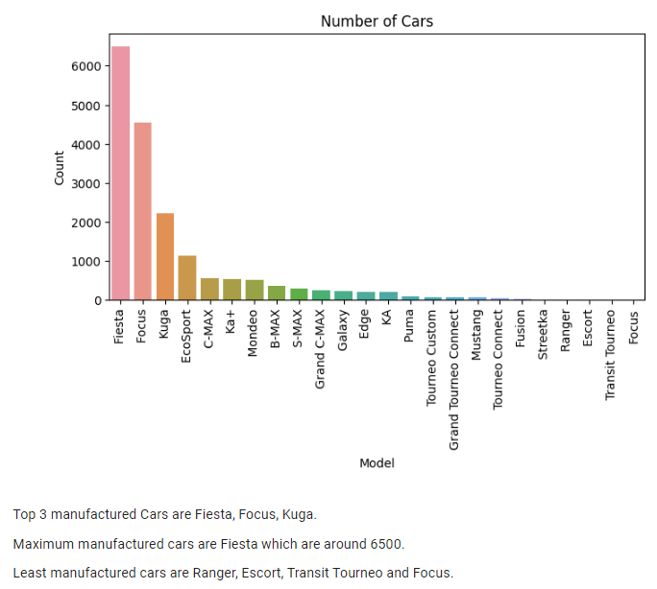
Visualization – Count plot

Slide 9
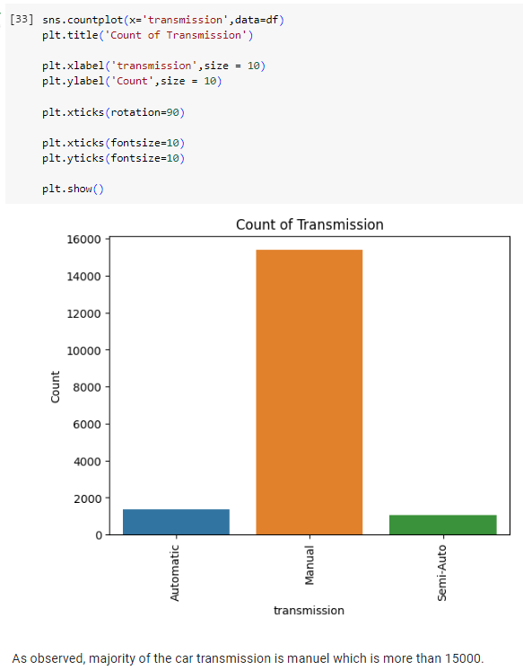
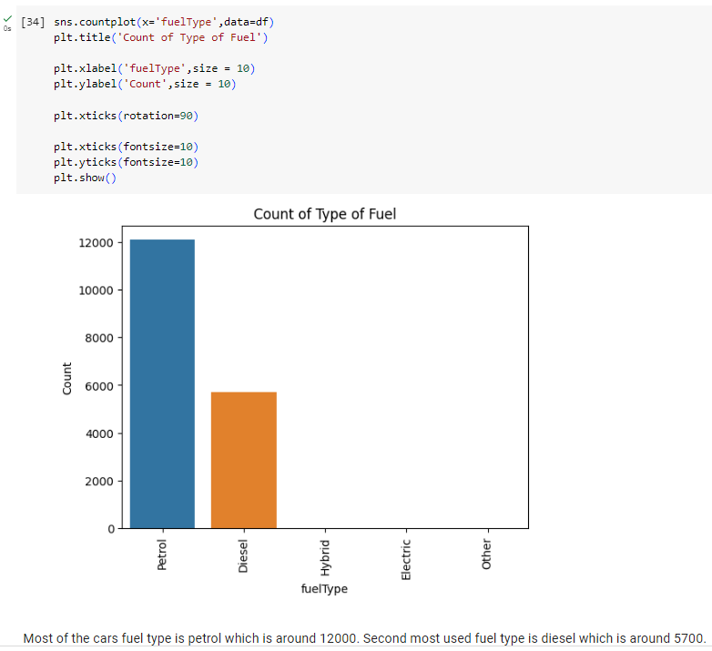

Slide 10
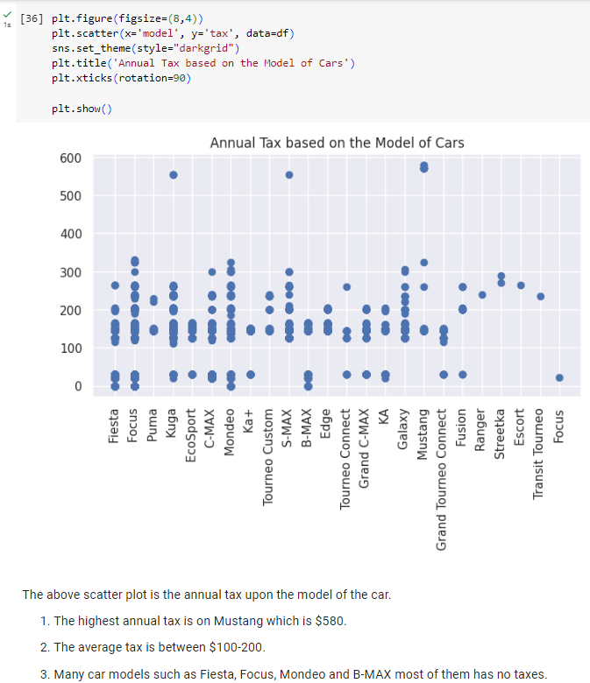
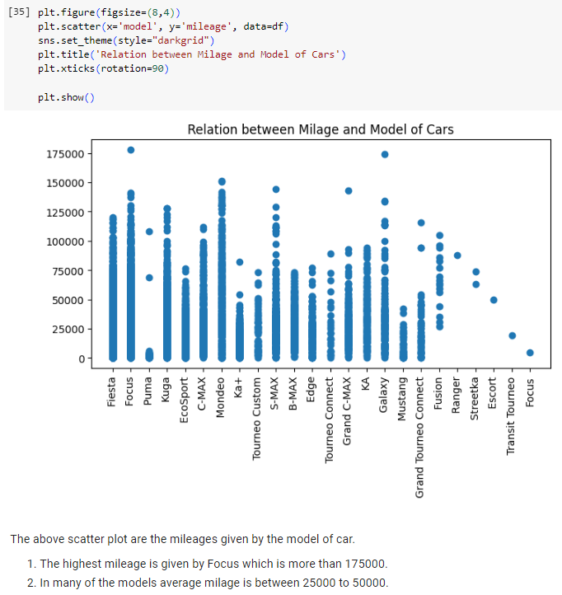
Visualization – Scatter plot

Slide 11
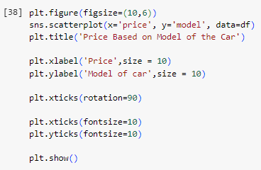
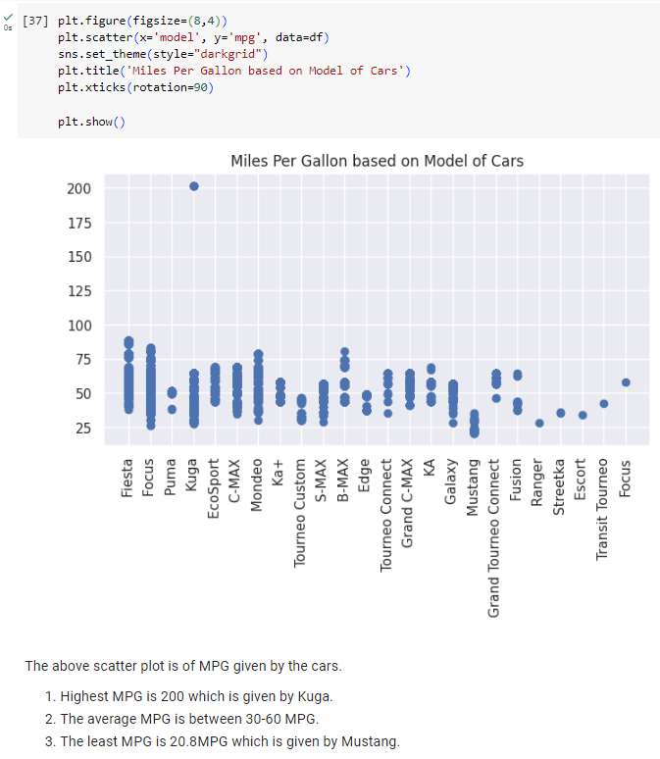
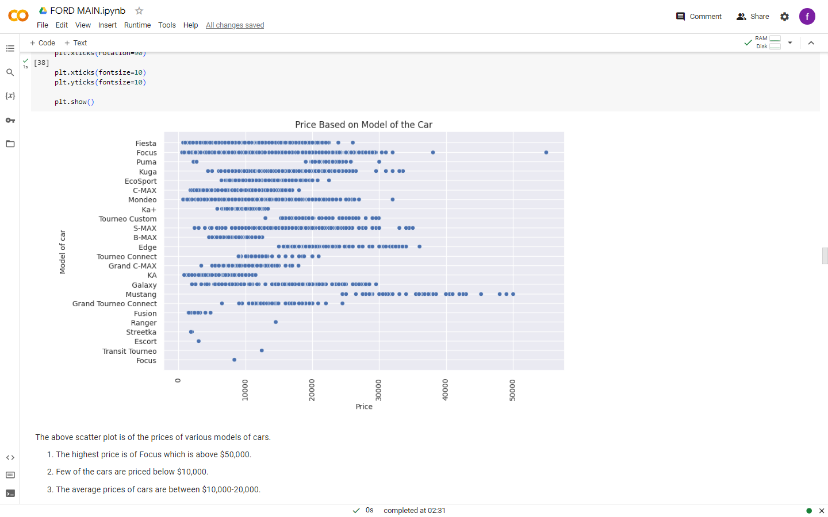

Slide 12
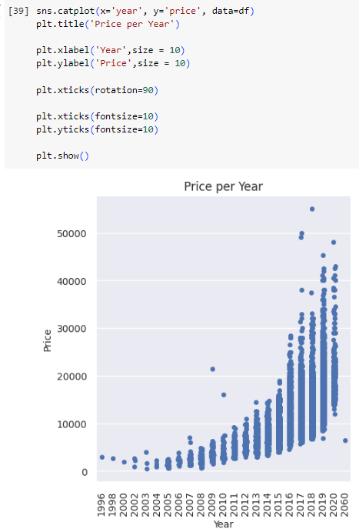
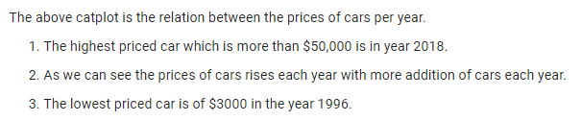
Visualization – Cat plot

Slide 13
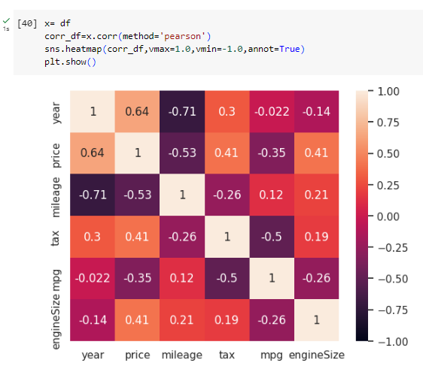
Visualization – Heat Map

Slide 14
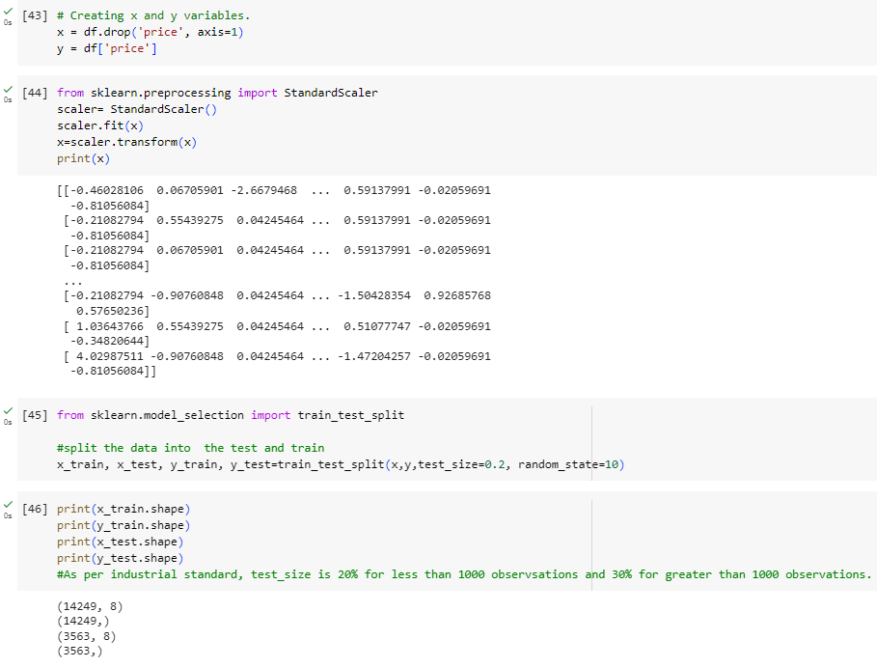
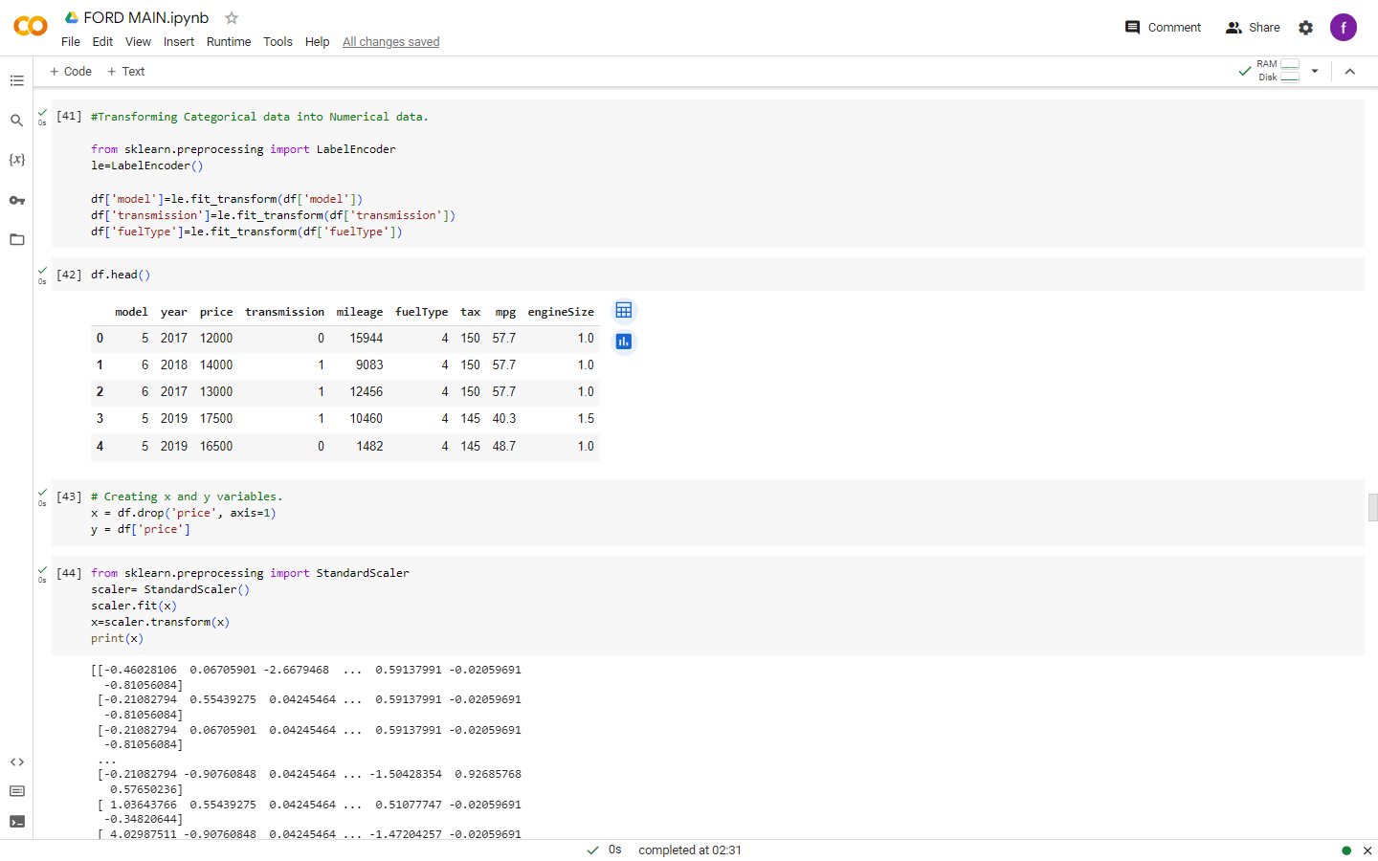
Train & Test Split

Slide 15
Model Building
Model Selection:-
Choosing appropriate machine learning algorithms for car automobile car price prediction. Common models includes linear regression, random forests, decision tree, support vector machines (SVM) and advanced techniques like gradient boosting and neural networks.
Building the following models
Linear Regression
Decision Tree
Random Forest
Support Vector Regression
XGBoost Regressor
Tuned Random forest using GridSearchCV

Slide 16
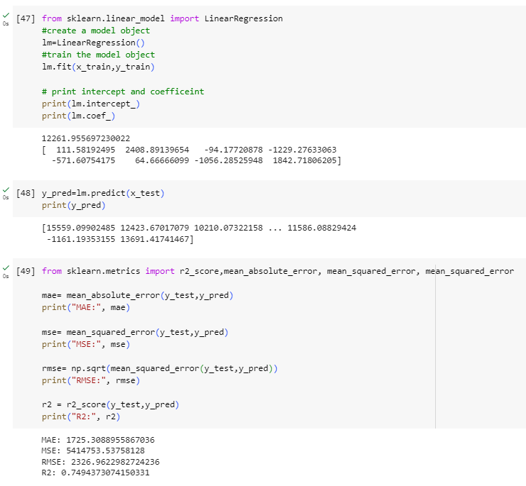
Linear Regression
Linear Regression values:-
MAE = 1725.308896, MSE = 5.414754e+06, RMSE = 2326.962298, R2 = 0.749437

Slide 17
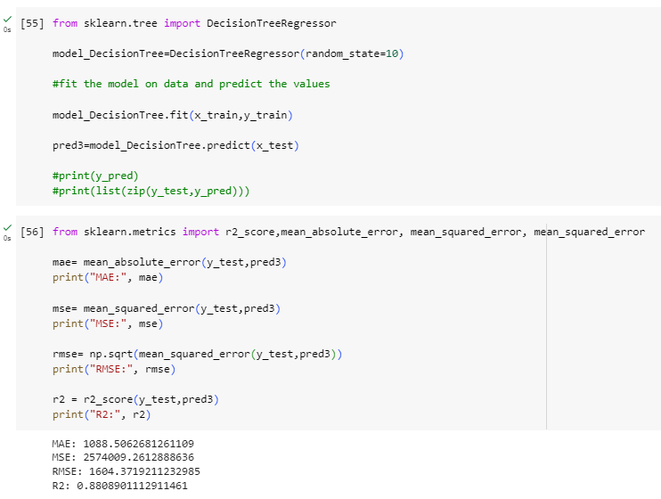
Decision Tree
Decision Tree values:-
MAE = 1088.506268, MSE = 2.574009e+06, RMSE = 1604.371921, R2 = 0.880890

Slide 18
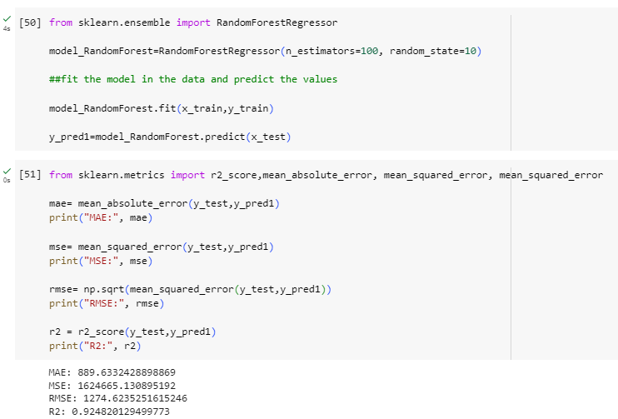
Random Forest
Random forest values:-
MAE = 889.633243 , MSE = 1.624665e+06, RMSE = 1274.623525, R2 = 0.924820

Slide 19
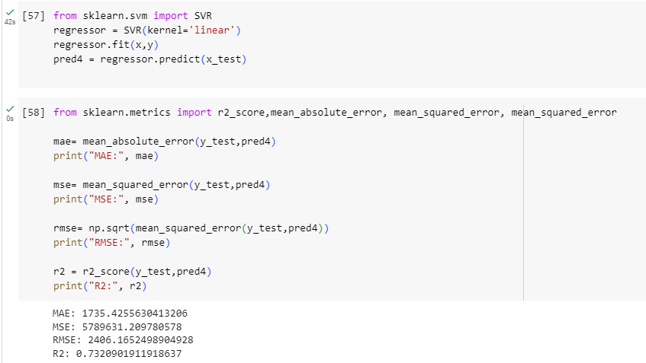
Support Vector Regression (SVM)
SVM values:-
MAE = 1735.425563, MSE = 5.789631e+06, RMSE = 2406.165250, R2 = 0.732090

Slide 20
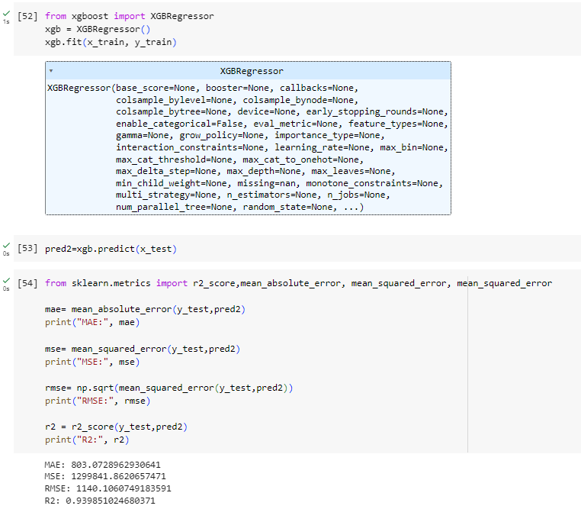
XGBoost Regressor
XGBoost values:-
MAE = 803.072896, MSE = 1.299842e+06, RMSE = 1140.106075, R2 = 0.939851

Slide 21

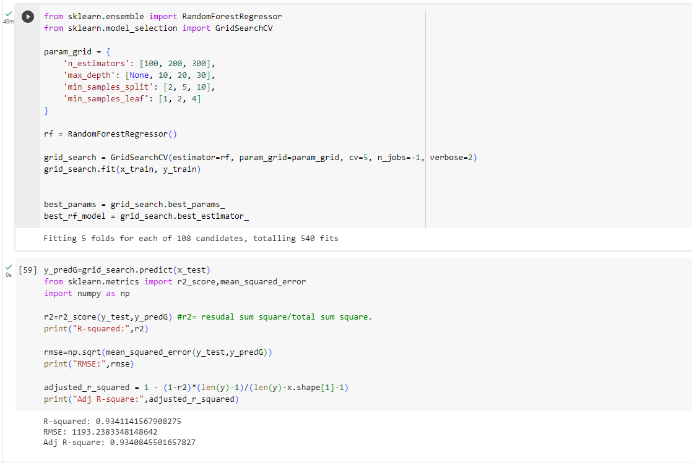
HYPER PARAMETER TUNING
Tuning Random Forest Regressor using GridSearchCV
Tuned Random Forest values:-
MAE = 835.592968, MSE = 1.423818e+06, RMSE = 1193.238335, R2 = 0.934114

Slide 22
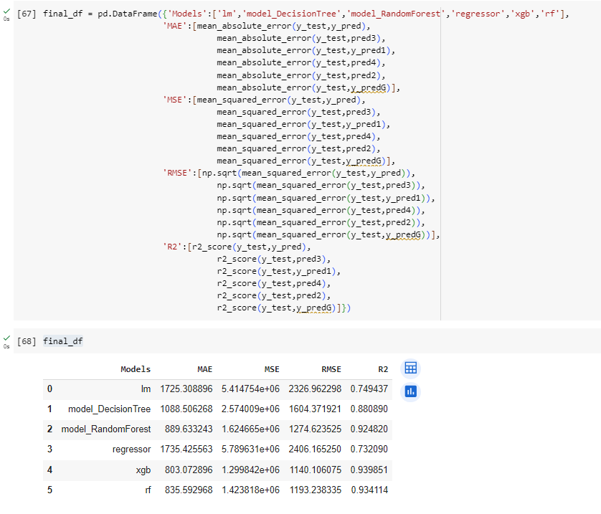
All models tabled

Slide 23
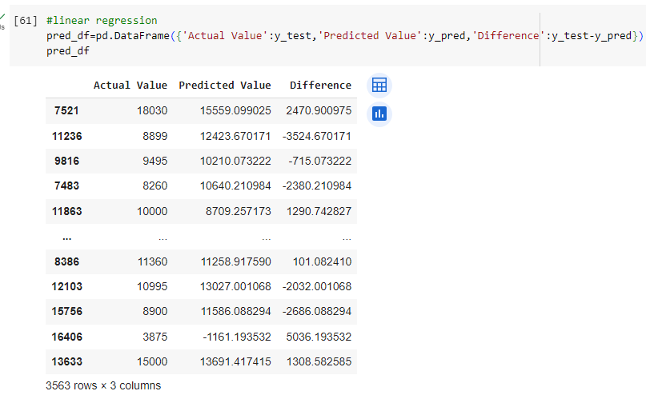
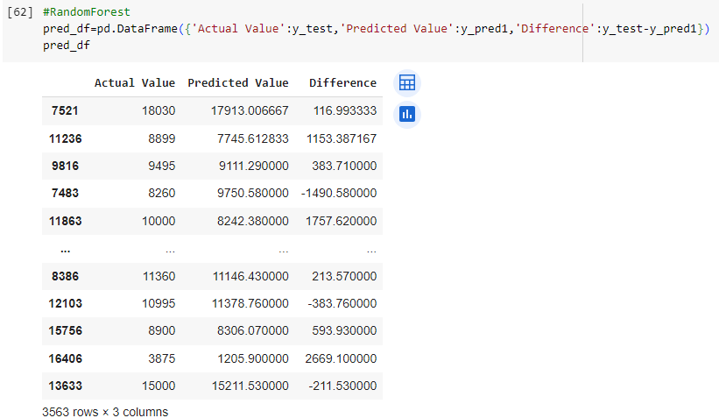
Predicted Values By Models

Slide 24
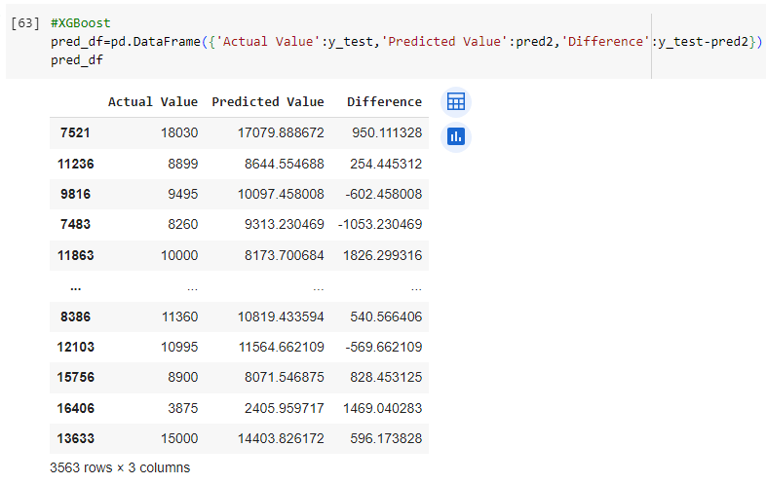
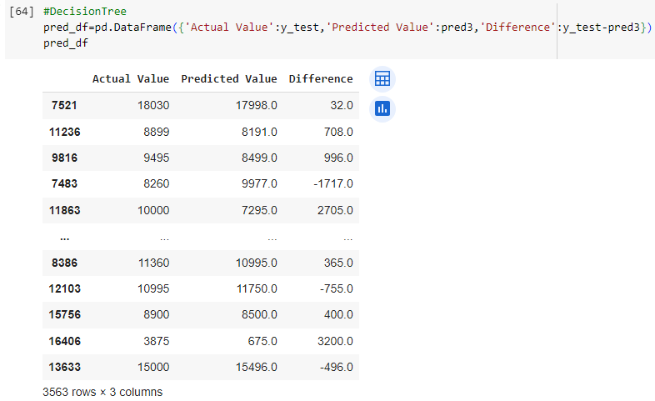

Slide 25
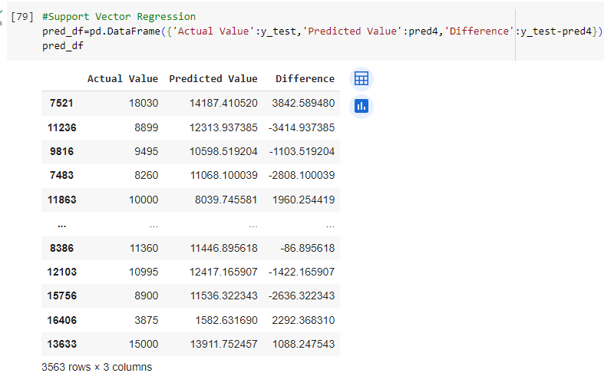
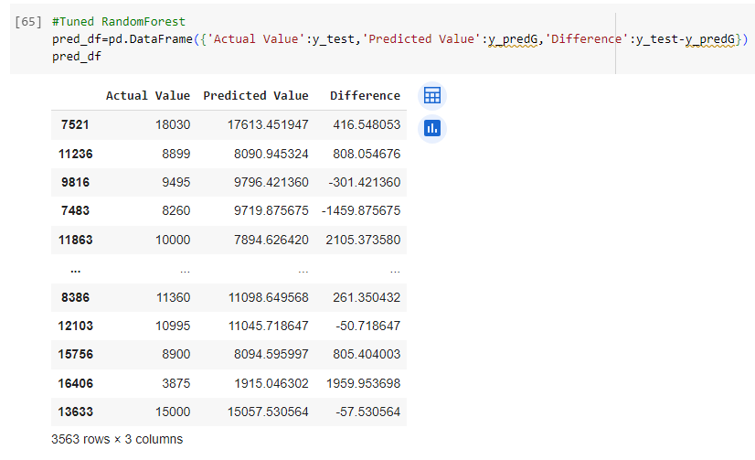

Slide 26
Conclusion
All the models mentioned above shows good MAE, MSE, RMSE and R2 values.
After hyperparameter tuning the random forest model using grid searchCV the model has improved in as seen by the R2 score.
However, XGBoost regressor which is an advanced ensemble machine learning algorithm gives the best values considered MAE = 803.072896, MSE = 1.299842e+06, RMSE = 1140.106075, R2 = 0.939851.

Slide 27
Thank you!!!

